Slide 1
LGB
ROLON
REQUEST FOR QUOTATION
[GPDN Line]
[Vallam Plant ]
Revision
Date
Prepared by
Approved by
Rev00
07.05.2026
[Anandakumar R]
[Sujith M]

Slide 2
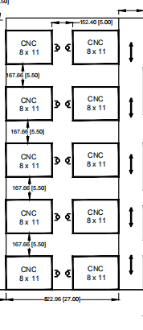
Current Machine Layout
LGB
LAYOUT NOTES & PART SUMMARY
Part No.
Monthly Qty
OP10
OP20
Weight
1564B
13,000
119 sec
100 sec
1 kg
1563
13,000
44 sec
105 sec
1 kg
Key Notes:
Total CNC machines: 04
Components:
Layout can be modified per vendor proposal

Slide 3
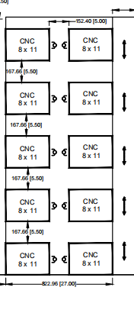
Part Details
LGB
[ INSERT COMPONENT IMAGE ]
COMPONENT IMAGE
MACHINE LAYOUT
Part No.
1218
Total No.of M/C in OP20
1
OP 10 CNC Model
Fanuc Series Oi-TF Plus(LMW)
OP 20 CNC Model
Fanuc Series Oi-TF Plus(LMW)
Cycle Time OP 10
[83 sec]
Cycle Time OP 20
[83 sec]
Total No.of M/C in OP10
1
Weight (approx.)
[1 kg]

Slide 4
Part Details
LGB
[ INSERT COMPONENT IMAGE ]
COMPONENT IMAGE
MACHINE LAYOUT
Part No.
Total No.of M/C in OP20
1
OP 10 CNC Model
Fanuc Series Oi-TF Plus(LMW)
OP 20 CNC Model
Fanuc Series Oi-TF Plus(LMW)
Cycle Time OP 10
[83 sec]
Cycle Time OP 20
[83 sec]
Total No.of M/C in OP10
1
Weight (approx.)
[1 kg]

Slide 5
Commercial Proposal Template
LGB
Item / Parameter
Vendor Fill Here
Notes
Robot Configuration
PLC Program / Logics
₹ ___________
Project Management
₹ ___________
Drawing & Documentation
₹ ___________
Gripper (Robots)
₹ ___________
Gripper (Packing)
₹ ___________
Pedestal
₹ ___________
Fencing
₹ ___________
Conveyor / Movement
₹ ___________
HMI
₹ ___________
Control Panel
₹ ___________
AMR / 7th Axis
₹ ___________
Software AMR
₹ ___________
Installation & Comm.
₹ ___________
System Price (Excl. Robot)
₹ ___________
Sum of above
Total Robot Cost
₹ ___________
Per Robot Cost × Qty
Overall Project Total
₹ ___________
System + Robot Cost
Robot Warranty
[X] Year
Standard: 1 Year
Per Robot Cost (incl. system split)
₹ ___________
(System/Qty Robots) + Per Robot Cost

